Slide 1
Payme - Auto Fund out
Problem statement
Existing system has manual cashout feature as most of the merchant don’t actively login and have to trigger cashout manually instead we need to come up with a solution such there is automatic way to cashout (leveraging existing logic of cashout)
Functional Requirements
Auto Fund out - user can able to schedule the fund out below frequency types
Frequency Type Hourly
Non Functional Requirements
Merchant
Existing functionality
Queries asked
d

Slide 2
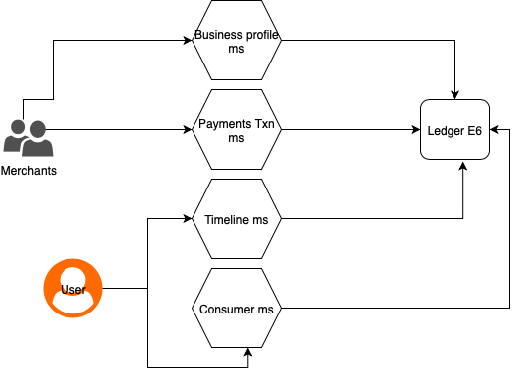
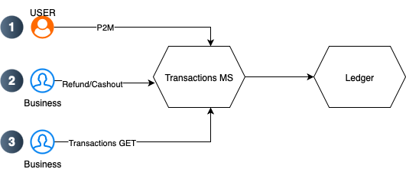
Peak Hour Transaction Slowness
SITUATION
Performance degradation during peak hours for key transaction APIs Payments, Refunds, Cashouts, Transaction Status — impacting user experience and system reliability.
TASK
Root cause of slowdown. Improve system performance, ensure stability, and scale for future growth.
FLOW

Slide 3
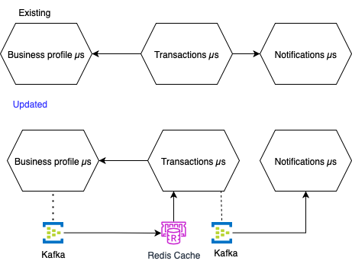
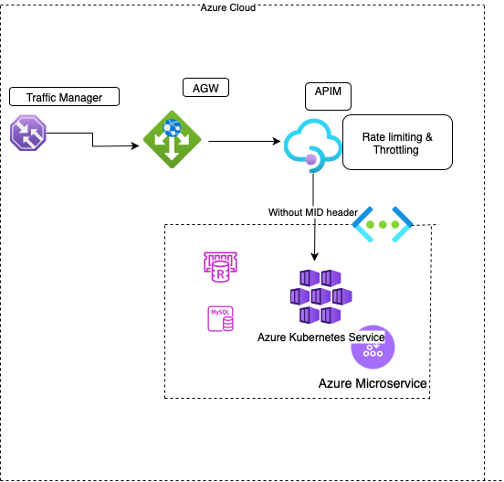
ACTION
1. Application Logic
Decouple Blocking calls: Enhanced system concurrency and throughput by decoupling blocking calls into a non-blocking, event-driven design, especially for non-essential operations like transaction notifications.
Reuse Ledger Token: Instead of creating new tokens for each operation on Ledger reuse the first created token for every operation on ledger irrespective of merchants calling.
Caching: Moved frequently accessed business metadata to a Redis cache with defined TTL, significantly improving api response times.Evicted cache on update of business via events
System Stability: Multiple reconciliation request are made during peak hour despite 5xx error from ledger.Implemented circuit breaker for Reconciliation process.
2. Infrastructure & Resilience
Limit Traffic:
Throttling: Controlled flow of Social Timeline requests which calls ledger
Rate Limiting: Prevented system abuse by limiting frequent status checks from individual merchants

Slide 4
ACTION
3. Database & Resource Management
Read/Write Segregation: Get API calls read from MySQL Read Replica instead live and cached .
Query Optimization:
Ensured queries utilized indexes correctly. Restructured JOIN order and ensured left table is smaller table followed by larger table.
Denormalized data where appropriate to avoid extra round trip API calls.
Efficient Pagination: Switched from Spring Page to Spring Slice. Eliminated costly COUNT query performing full table scan
Connection Pooling: Used robust connection pooling techniques Tomcat (Azure) and RDS Proxy (AWS).
Liquibase for versioning of db changes ,helped to keep track of index changes
RESULT
Measurable Performance Gains
Drastic Latency Reduction Achieved faster response times during peak traffic
Increased Throughput System capacity increased, successfully handling more Transactions Per Second (TPS) 20 TPS to 80 TPS
Enhanced Stability Circuit Breaker pattern reduced cascading failures from the Ledger
Proactive Monitoring New dashboards reduced our Mean Time To Resolution (MTTR) by enabling us to identify and fix potential issues before they became critical.
Metric | Before | After | Improvement
Response time | ~15 seconds | ~2 seconds | 86%
TPS | 20 | 80 | 300 %
Error rate | 20% | ~0.5% | 97%
Database Load | 85% | 40% | 52.94

Slide 5
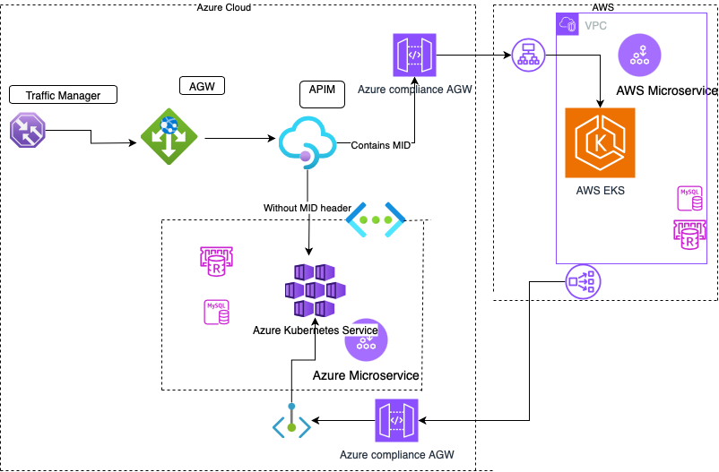
AWS MIGRATION FROM AZURE
SITUATION
HKMA mandated 15-day pilot testing on AWS without disrupting live Azure traffic
TASK
Differentiate traffic routing between Azure and AWS environments
Implement phased migration approach across multiple service batches(1,2,3,4)
Ensure seamless user experience during transition period
ACTION
Header-Based Routing Implementation
Entry points configured to pass the migration ID in the pilot apps or service
Implemented x-migration-id header system (values 1-4) for batch identification
Notes:
rules

Slide 6
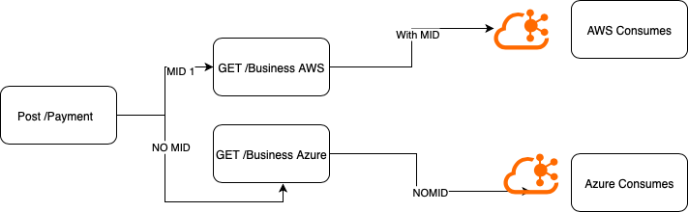
AWS MIGRATION FROM AZURE
ACTION - Header-Based Routing Implementation
Configured phased migration approach: Batch 1: MID = 1 Batch 2: MID = 2 Batch 3: MID = 4 Batch 4: MID = 4
Each microservice configured with cloud-specific endpoints in Key Vault/Secret Manager eg) no migration id Azure endpoint called ,with migration id aws endpoint is called
OpenID config URLs mapped to corresponding cloud environments
Separate Consumer created for aws, events with mid processed on aws and without on azure
Migrated microservices use corresponding cloud redis , sql, secret manager.
Retained on Azure: Active Directory/ADB2C and EventHub (planned for later migration)
RESULT
Successfully enabled parallel operation of Azure and AWS environments
Achieved traffic segregation without service disruption
Established foundation for controlled, phased migration execution
Maintained regulatory compliance with HKMA requirements

